Slide 1

SSB Abstracts 2021 Analysis
SURAJ GOEL
Graduate Research Assistant
3/16/2022

Slide 2
Contents
Exploratory Data Analysis
Topic Modeling
Word Clouds

Slide 3
Exploratory Data Analysis Results Summary
Department of Management and Information Systems has the highest number of abstracts in 2021
Iowa State University collaborated maximum number of times with Oklahoma State University
Kevin Kam Fung So has the maximum number of abstracts under his name as PID

Slide 4
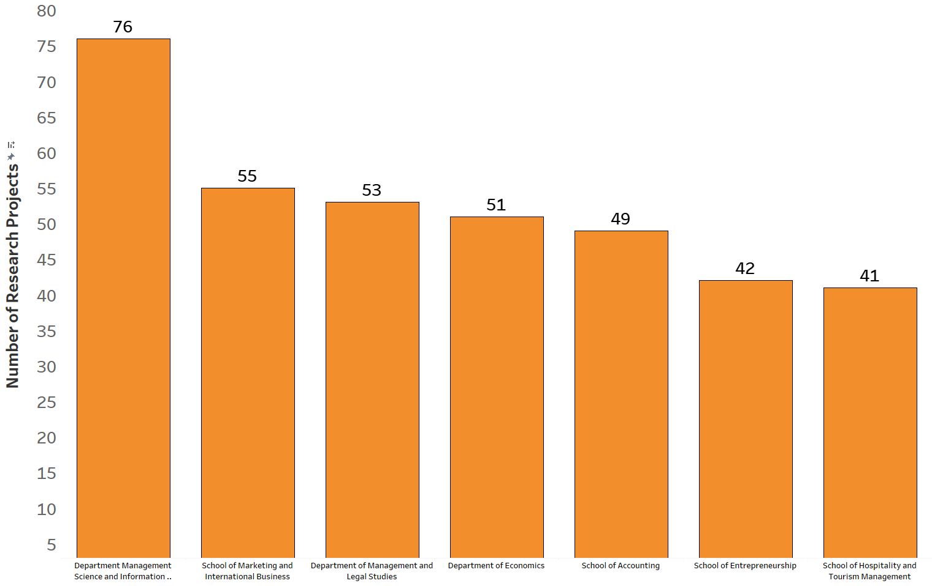
Number of abstracts per department

Slide 5
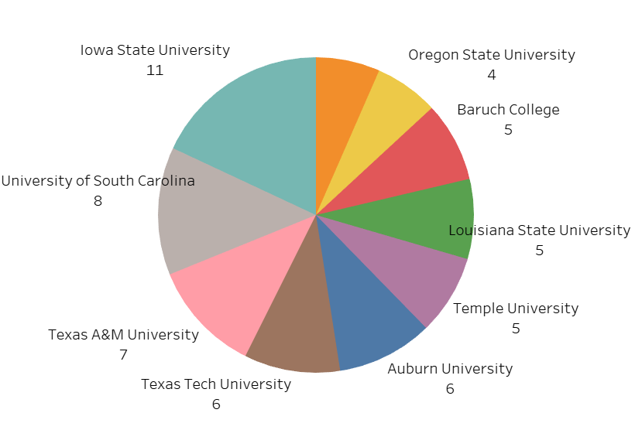
Top 10 universities collaborated with Oklahoma State University

Slide 6
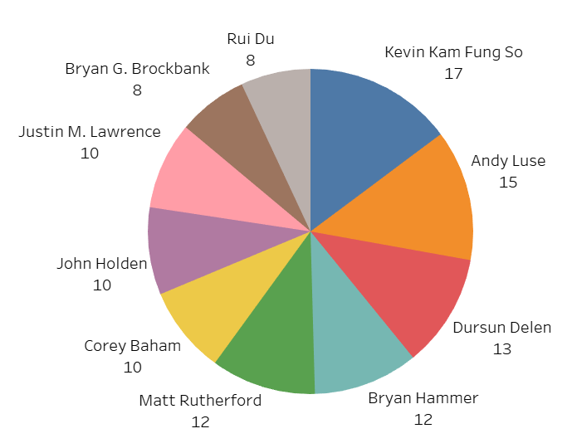
Overall Top 10 PIDs

Slide 7
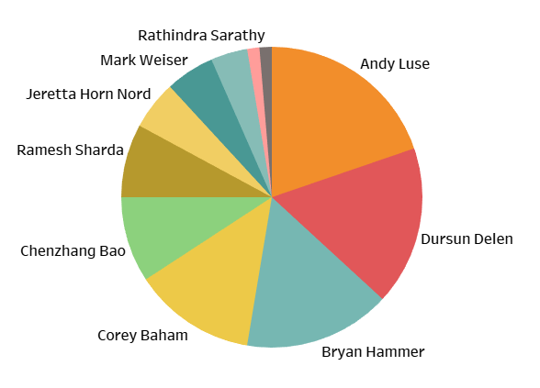
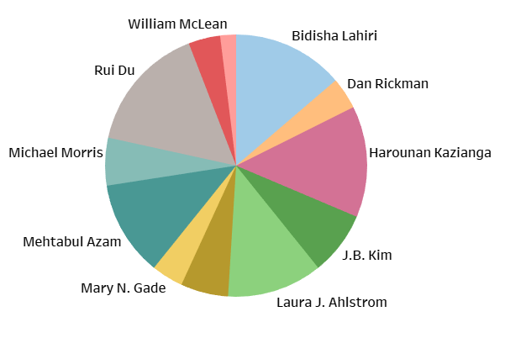
Management Science & Information Systems PIDs
Department of Economics PIDs

Slide 8
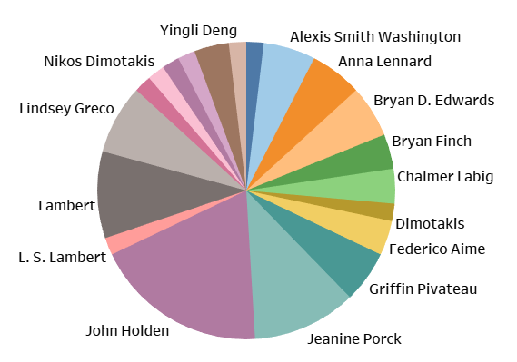
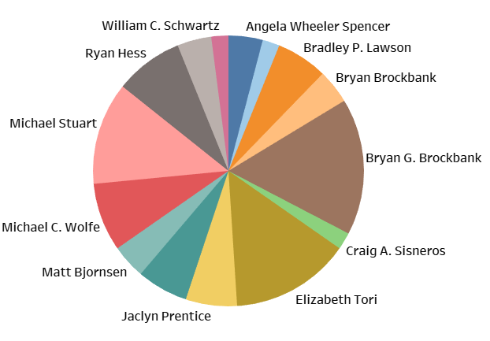
Department of Management and Legal Studies PIDs
School of Accounting PIDs

Slide 9
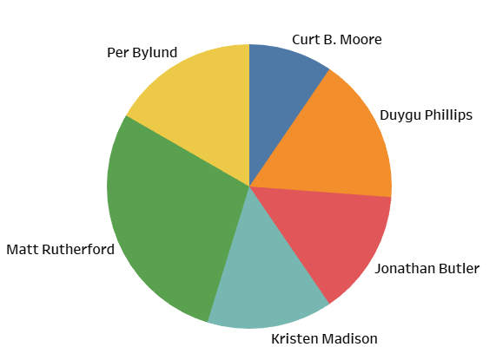
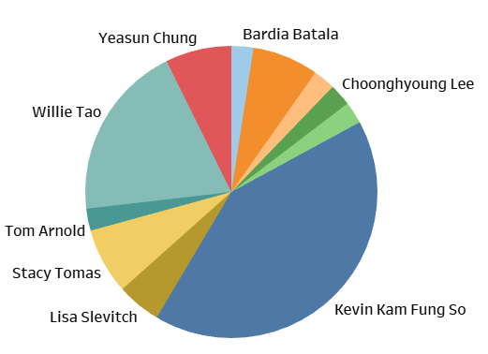
School of Entrepreneurship PIDs
School of Hospitality and Tourist Management PIDs

Slide 10
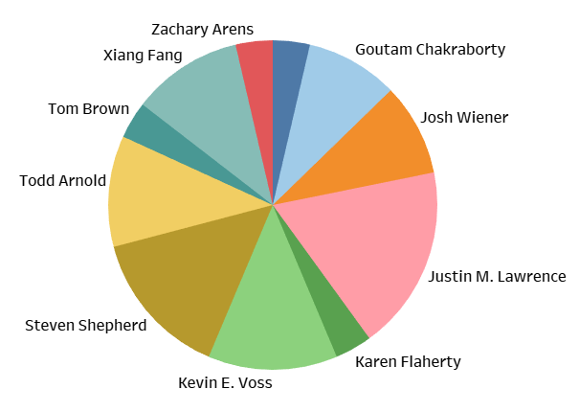
School of Marketing and International Business PIDs

Slide 11
Topic Modeling Results Summary
8 topics were created after topic modeling, each topic signifies each of the departments
Topic 0 is the most frequent topic, contains terms like audit, tax which shows abstracts topics related to Department of Accounting.
As per intertopic distance, topics 1, 3 & 4 are closer to each other signifies abstracts are closely related for these.
Also, topics 0, 2, 5, 6 & 7are closer to each other.

Slide 12
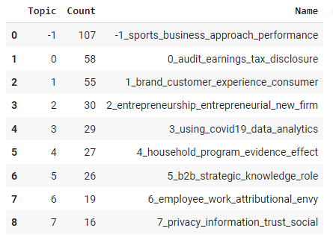
Topics Info
-1 is ignored as it is an outlier
We will consider topic 0 to 7

Slide 13
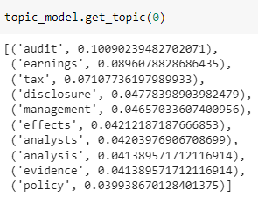
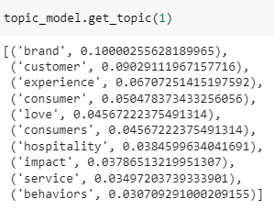
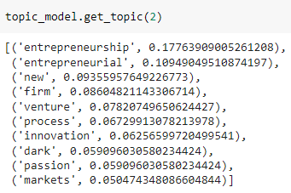
Terms in topics 0-2

Slide 14
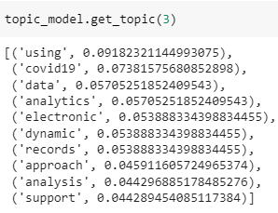
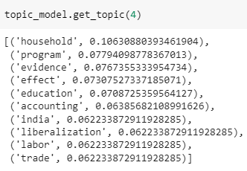
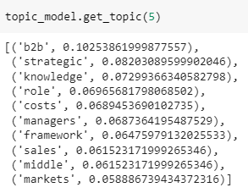
Terms in topics 3-5

Slide 15
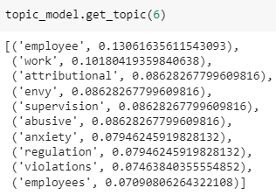
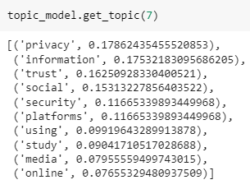
Terms in topics 6-7

Slide 16
Intertopic Distance Map

Slide 17
Word Clouds Word Cloud results are based on each department

Slide 18
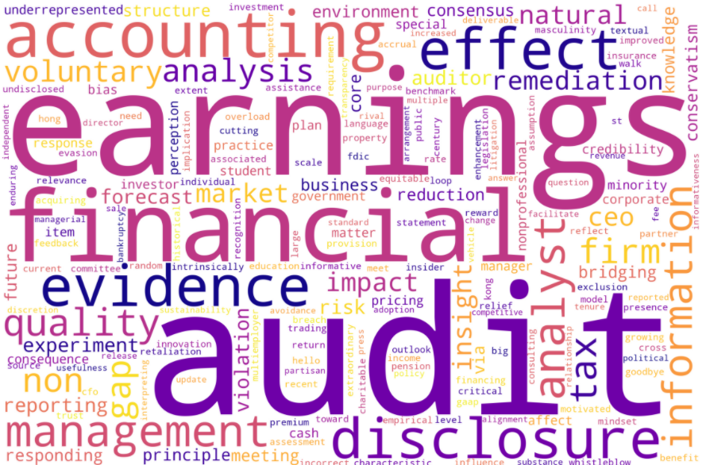
School of Accounting

Slide 19
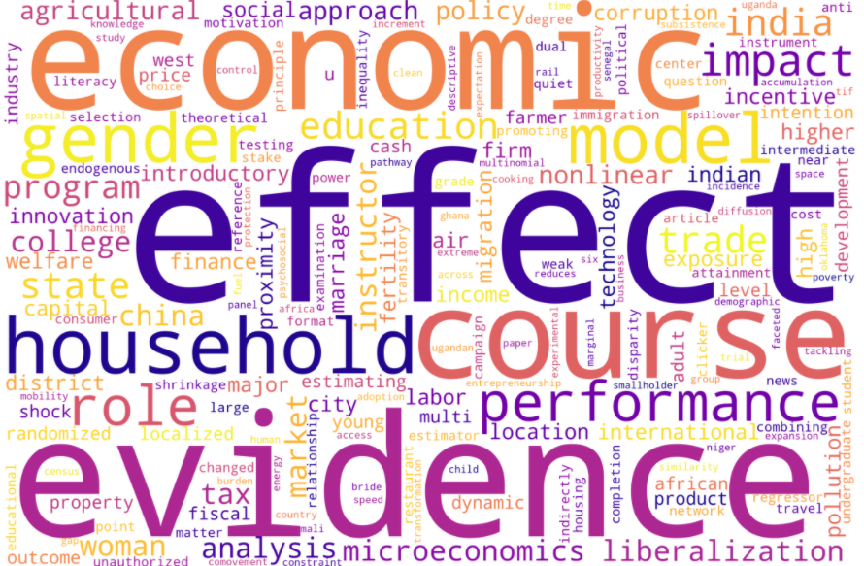
Department of Economics

Slide 20
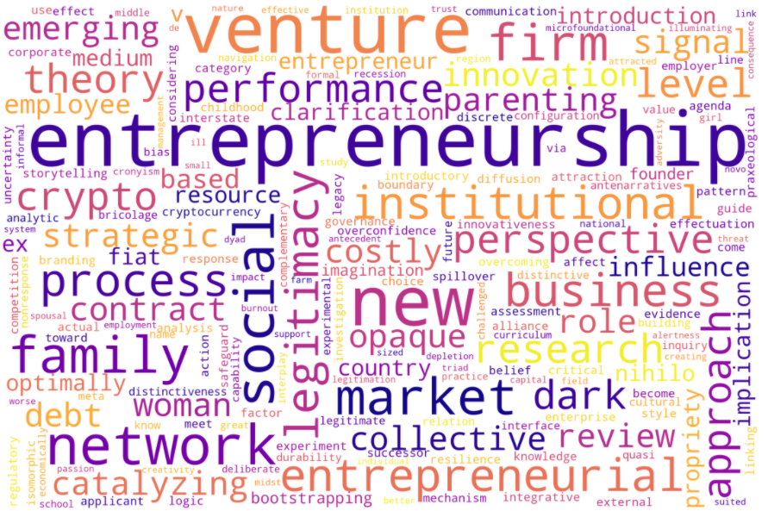
School of Entrepreneurship

Slide 21
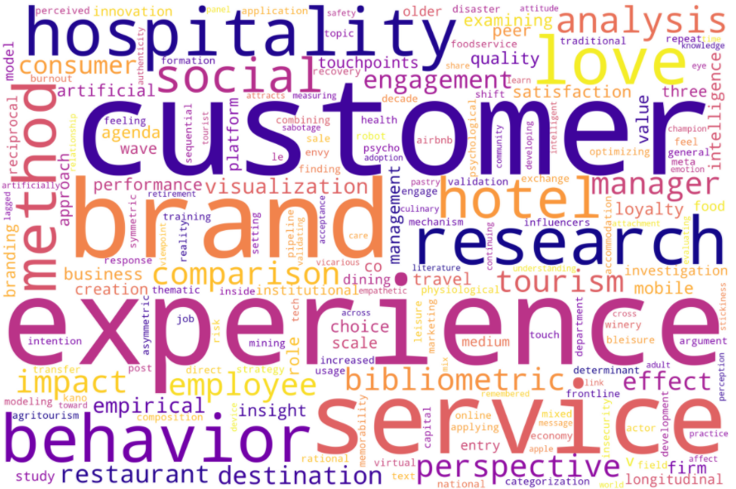
School of Hospitality & Tourism Management

Slide 22
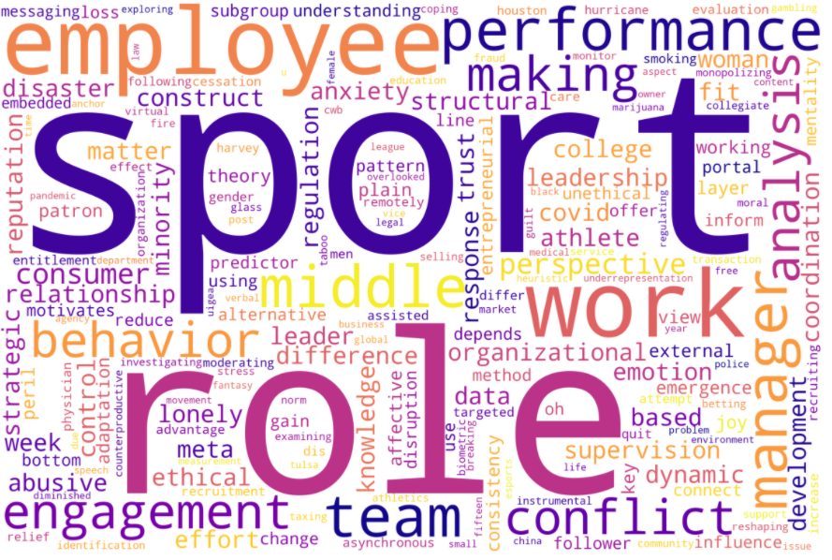
Department of Management and Legal Studies

Slide 23
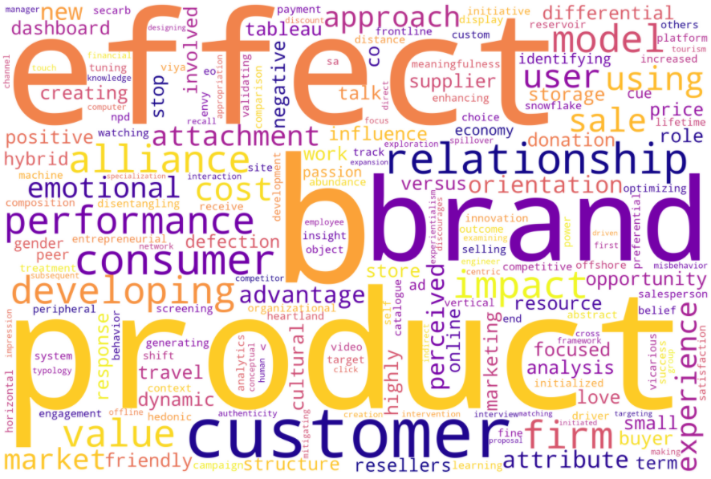
School of Marketing and International Business

Slide 24
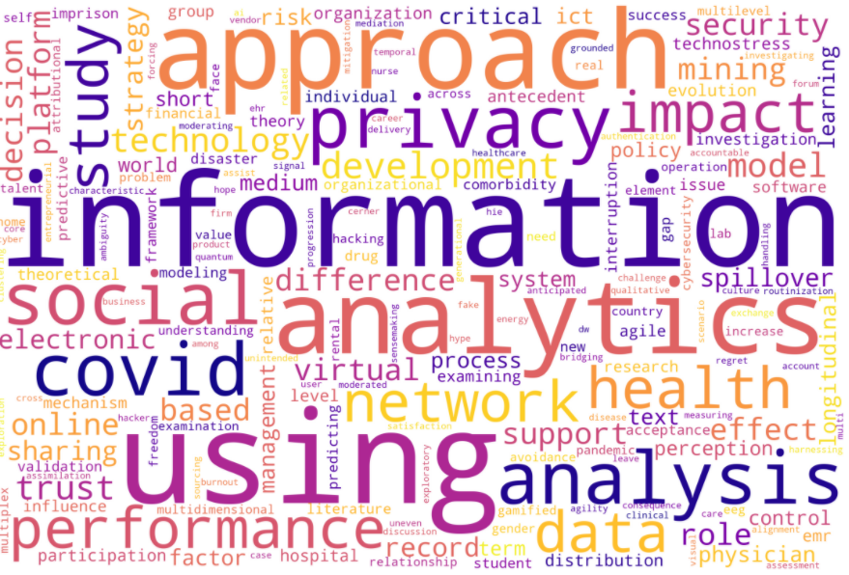
Department Management Science & Information Systems

